Slide 1
New In-Store Customer Service Counters
Contoso Electronics

Slide 2
Goal Flowchart
Six Months to One Year of Use
Return for New Model
Customers Purchase
Primary Goal: With the success of our latest line, we are pushing forward to create device bar experience that will invoke and maintain brand connection.

Slide 3
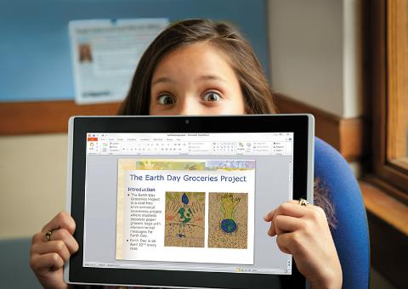
Creating a Connection
Inspiring brand loyalty starts with encouraging buyers to return for new lines
How do we connect with the consumer?

Slide 4
Brainstorm Session
Discuss branding options for the fall launch
What are reasonable expectations for customer return rate?

Slide 5
FY January to July Goals
Jan-Feb
Continue Ad Campaign for the New Line
Vary the Media to Increase Interest
March-April
Announce New Products
Make Sure Campaign is Distinct from Previous
May-July
Retain Brand Theme: “The Smile”
On Release, Stress New Features and Promote Recycling Old Products

Slide 6
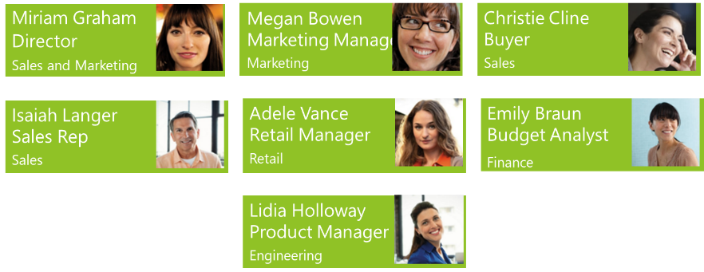
Project team

